Slide 1
GitHub (Scripts, Local Run): t.ly/VRj8T Google Colab (Notebook, Cloud): t.ly/C1Nxe ^Ctrl+S, Save Copy for yourself

Slide 2
Hands on with Deep Learning
Oliver Gyldenberg Hjermitslev
Alexandra Instituttet

Slide 3
Contents
Introduction + Exercises (10 min)
Thinking About Data
Good data, bad data, what is our goal?
Choosing a Model
What to be aware of, where to look, thinking architecture
Exercises (20 min)
The Training Loop
Loss, optimizers, validation techniques, detecting flaws in our regime
Is My Model Doing What it is Supposed To?
Breaking down the problem, debugging, and generalization
Exercises (20 min)
Final Thoughts

Slide 4
Introduction
The Alexandra Institute is a Danish GTS (RTO)
We specialize in IT and digital technologies
AI, Cybersecurity, Human Insights, Systems Architecture
Oliver Gyldenberg Hjermitslev
Senior Visual Computing Specialist
Focus on Data Analysis, 2D/3D Data, Neural Rendering
Tue Boesen
Visual Computing Engineer
Focus on Physics Informed Deep Learning, Data Science

Slide 5
Contents
Introduction
Thinking About Data
Good data, bad data, what is our goal?
Choosing a Model
What to be aware of, where to look, thinking architecture
Exercises
The Training Loop
Loss, optimizers, validation techniques, detecting flaws in our regime
Is My Model Doing What it is Supposed To?
Breaking down the problem, debugging, and generalization
Exercises
Final Thoughts

Slide 6
What is Deep Learning?
Artificial Intelligence (AI)
Machine Learning (ML)
Deep Learning (DL)

Slide 7
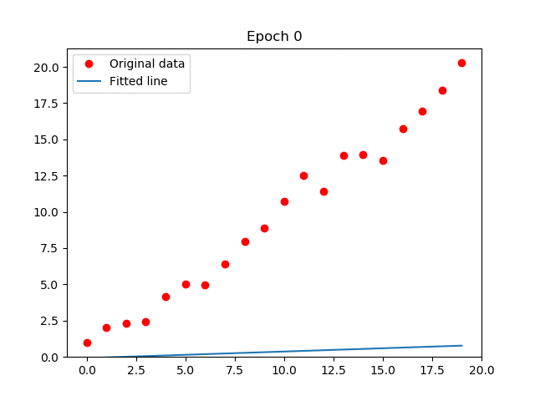
What is Deep Learning?
Select a model and fit an objective function on available data
Like (linear) regression with extra steps
Updating weights is the "learning"
Overfitting and underfitting
Image: https://raw.githubusercontent.com/arvention/linear-regression/master/animation.gif

Slide 8
Pros and Cons of Deep Learning
Abstracts a lot of tedious work (feature engineering)
State of the art performance
Good generalization
Endlessly customizable
Black box (mostly)
Huge data requirements
Prone to overfitting
Hard to debug
Computationally demanding

Slide 9
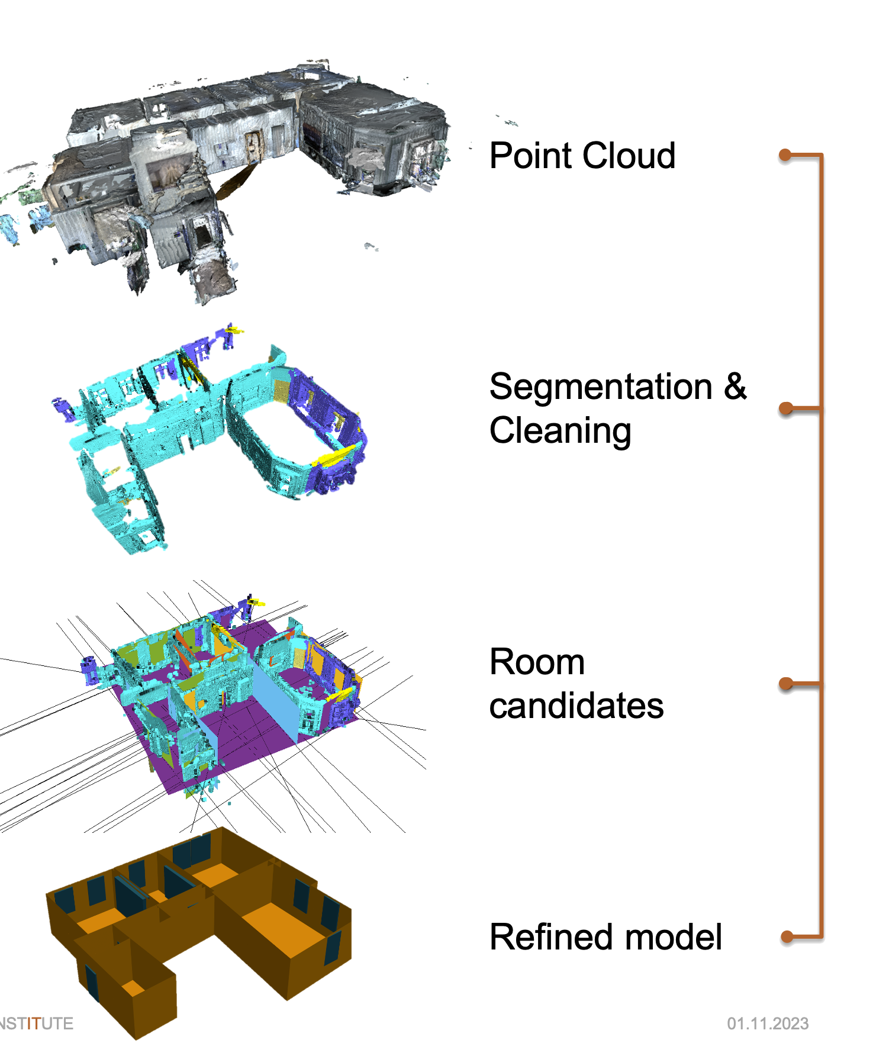
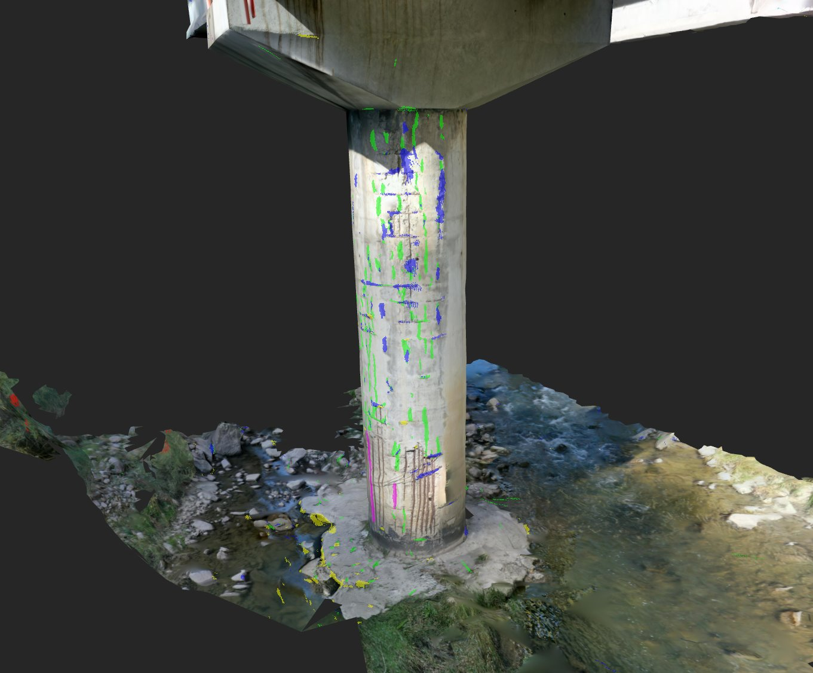
Examples of Use

Slide 10

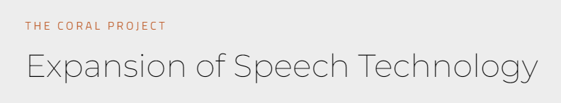
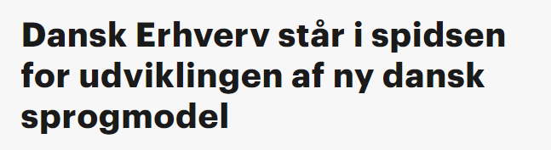
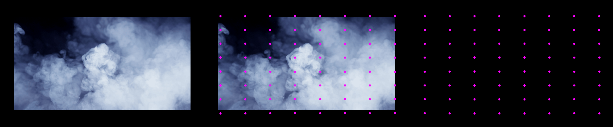
Examples of Use
Danish Language Models
Danish Speech to Text
Scientific Computing
Flow modelling
Etc etc etc

Slide 11
Deep Learning Frameworks
We use PyTorch
Pythonic
Flexible
Decent performance
Big ecosystem
Models
Transforms
Resources
There are other options
TensorFlow/Keras
Jax
Machine Learning libraries
Scikit
OpenCV (partially)

Slide 12
Exercise 0: Overview You should see a "loading bar"
t.ly/VRj8T | t.ly/C1Nxe GitHub | Google Colab
Est: 10 min

Slide 13
Contents
Introduction
Thinking About Data
Good data, bad data, what is our goal?
Choosing a Model
What to be aware of, where to look, thinking architecture
Exercises
The Training Loop
Loss, optimizers, validation techniques, detecting flaws in our regime
Is My Model Doing What it is Supposed To?
Breaking down the problem, debugging, and generalization
Exercises
Final Thoughts

Slide 14
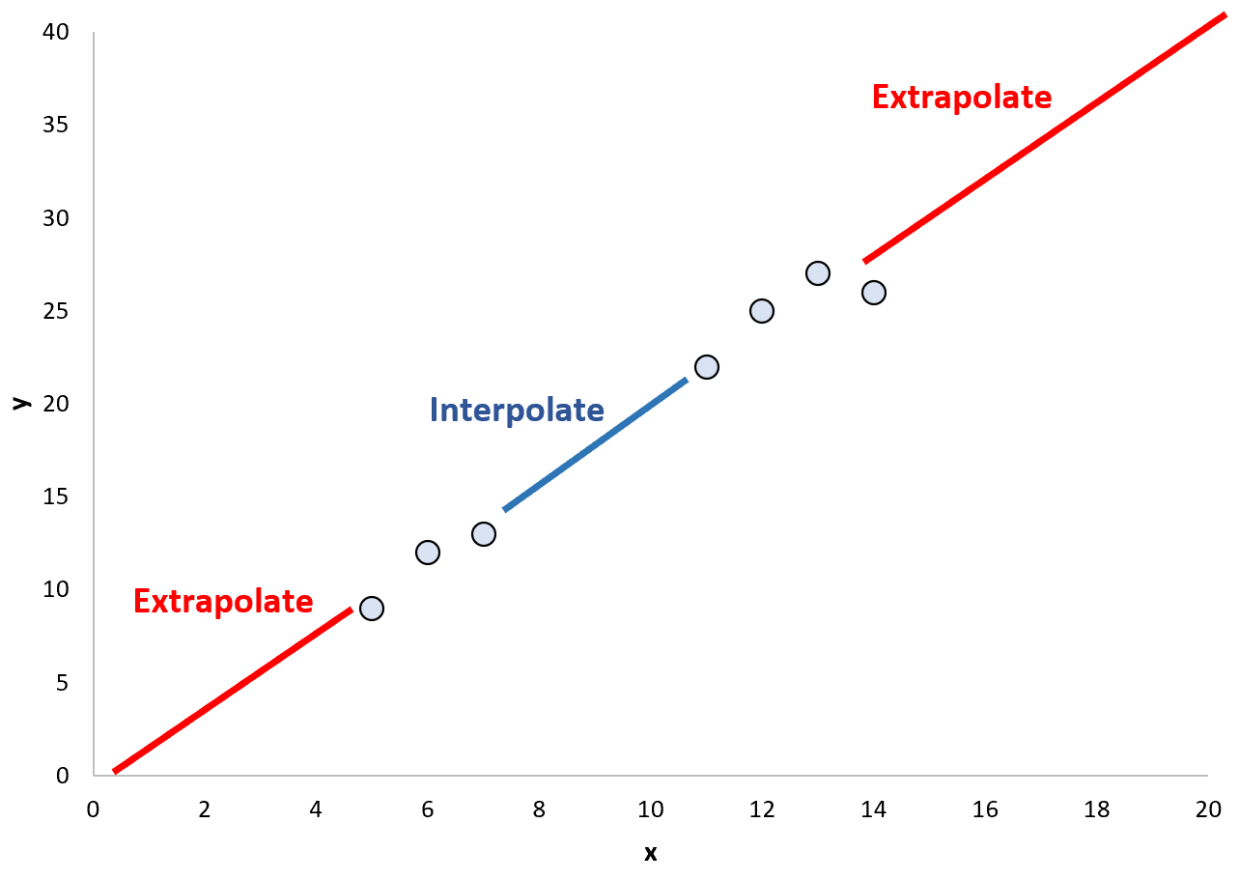
Interpolation and Extrapolation
Classification problems boil down to these
Often called Generalization
The "training distribution" should at least encompass the target distribution – and likely much more
Image: https://scales.arabpsychology.com/wp-content/uploads/2024/05/interp3.png

Slide 15
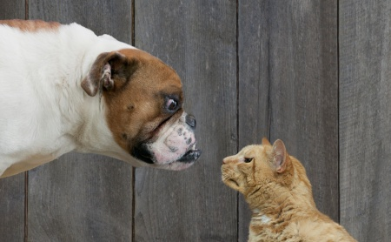
An Example
We want to know: Is it a CAT or a DOG?
What if it's both? Or none?
Image: https://www.kaggle.com/c/dogs-vs-cats

Slide 16
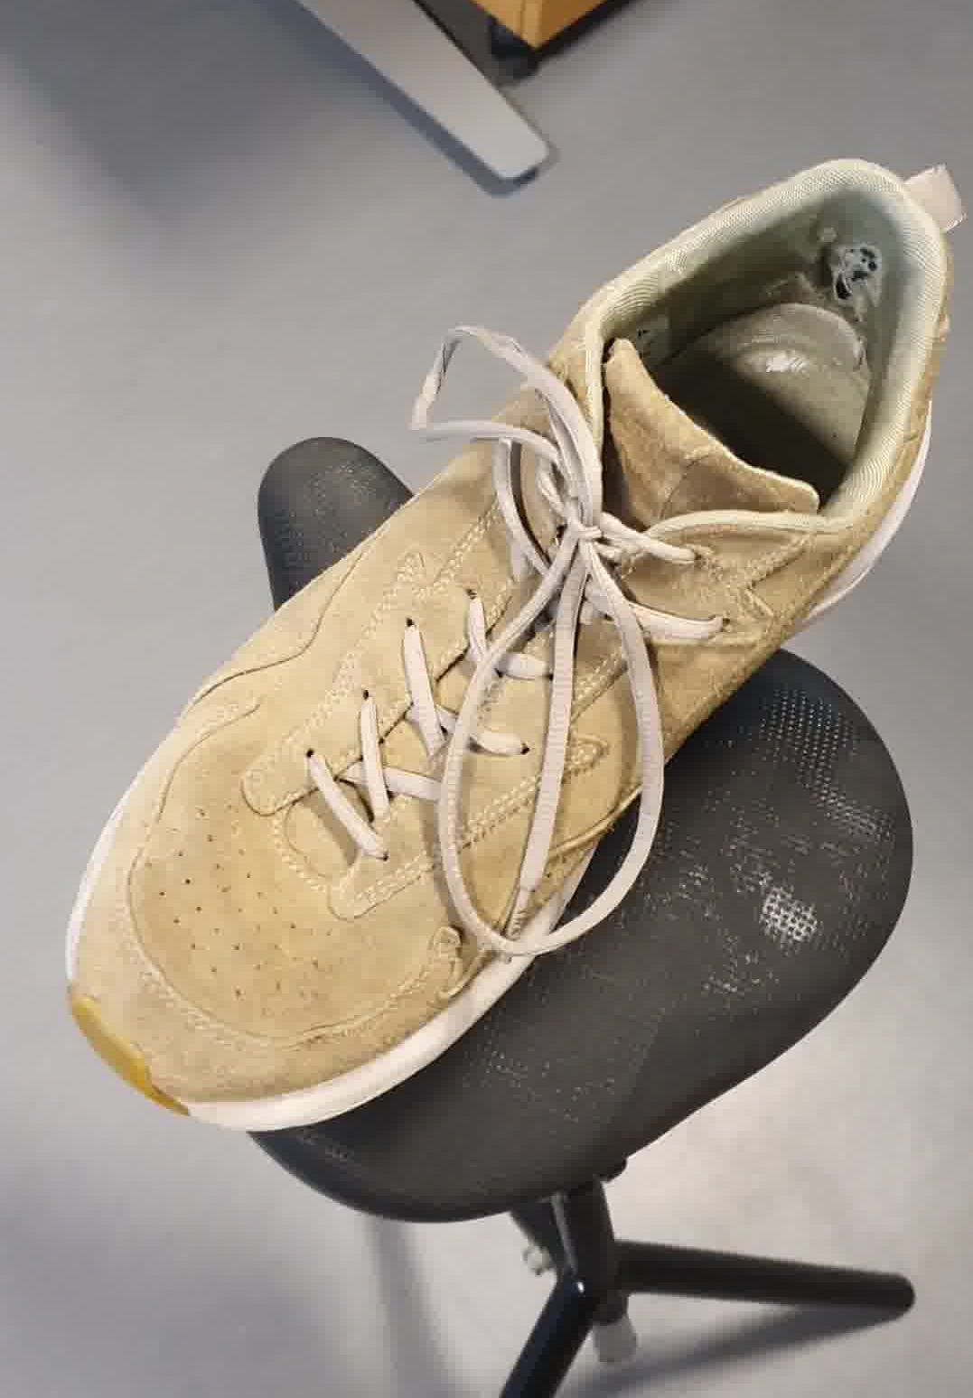
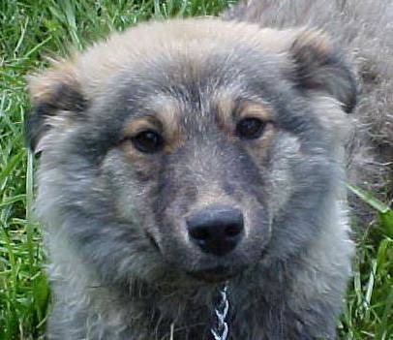
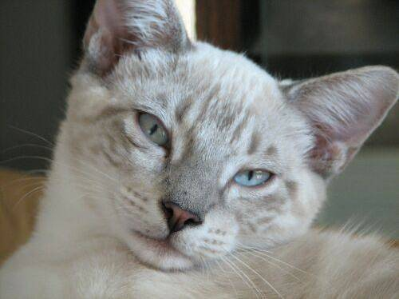
An Example

Slide 17
An Example (wrong way)
Doggyness score?

Slide 18
An Example (better)
Cattyness score
Doggyness score

Slide 19
An Example: 1st attempt
Cattyness score
0.4671...
0.6711...
Doggyness score

Slide 20
An Example: 1st attempt
Cattyness score
0.4671...
error = 0.5328...
error = 0.3288...
0.6711...
Doggyness score

Slide 21
An Example: 1st attempt
Cattyness score
0.4671..
error = 0.5328..
mean err = 0.4308..
error = 0.3288..
0.6711..
Doggyness score

Slide 22
An Example: 1st attempt
Cattyness score
0.4671..
error = 0.5328..
mean err = 0.4308..
error = 0.3288..
0.6711..
Doggyness score
Backpropagation: Backward propagation of errors

Slide 23
An Example: 100th attempt
Cattyness score
0.9872..
0.9998..
Doggyness score

Slide 24
An Example: Test set
Cattyness score
????
????
Doggyness score

Slide 25
An Example: Test set
Cattyness score
????
????
Doggyness score

Slide 26
Good Performance Requires Good Data

Slide 27
Bad Dataset

Slide 28
Good Dataset
Our Data
Dog images
Cat images
Both

Slide 29
Contents
Introduction
Thinking About Data
Good data, bad data, what is our goal?
Choosing a Model
What to be aware of, where to look, thinking architecture
Exercises
The Training Loop
Loss, optimizers, validation techniques, detecting flaws in our regime
Is My Model Doing What it is Supposed To?
Breaking down the problem, debugging, and generalization
Exercises
Final Thoughts

Slide 30
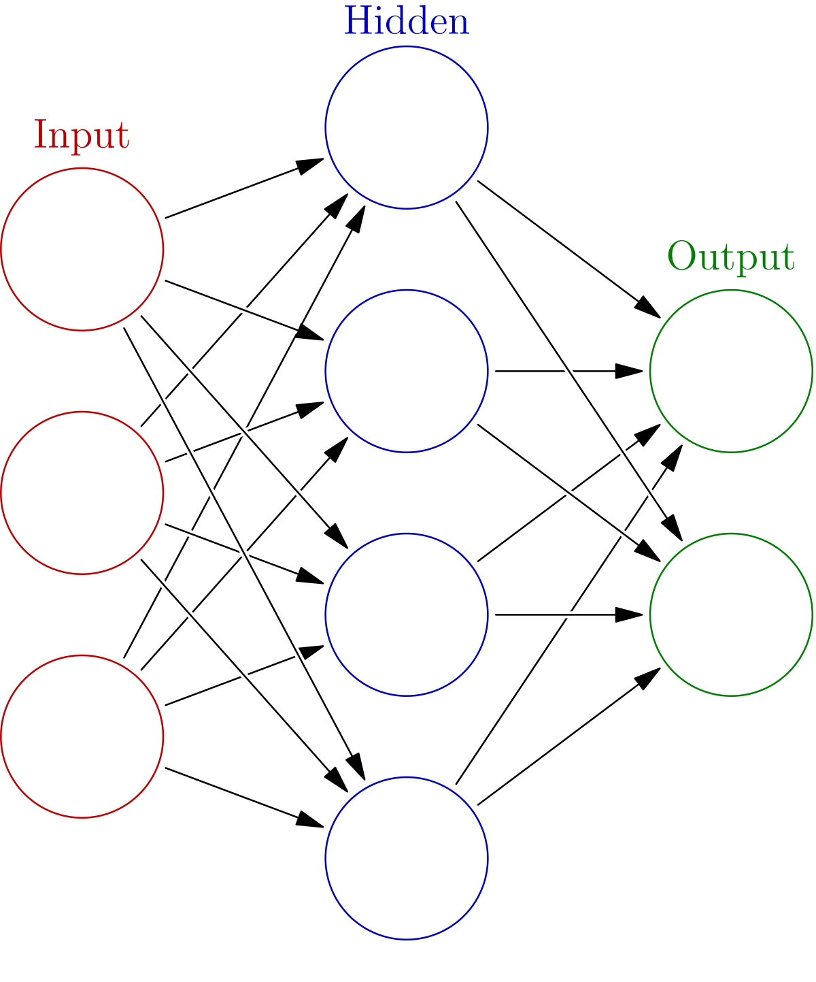
A Neural Network
Image: https://en.wikipedia.org/wiki/Neural_network_%28machine_learning%29

Slide 31
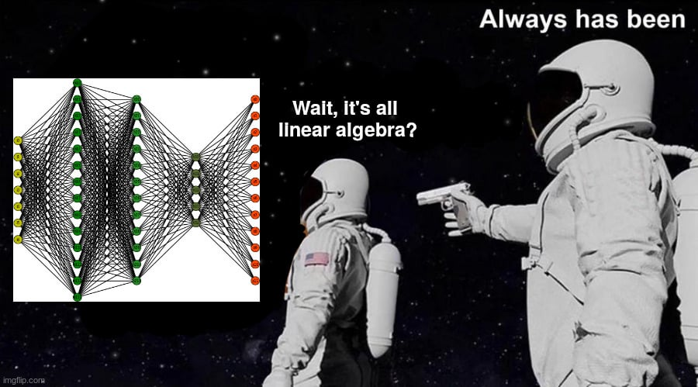
Choosing a Model
Goal
Classification, segmentation, object detection
Input type, Output type
Target device
Size, performance, accuracy
Familiarity, documentation
Ease of implementation
Start light, get a baseline

Slide 32
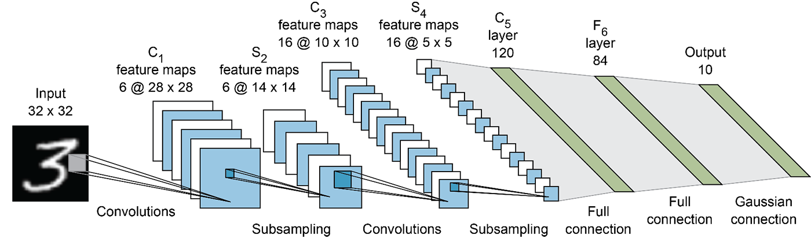
Convolutional Neural Networks
Great for image analysis
Operates on patches, and patches of patches, and patches of ...
Image: https://drek4537l1klr.cloudfront.net/elgendy/v-3/Figures/05_01.png

Slide 33
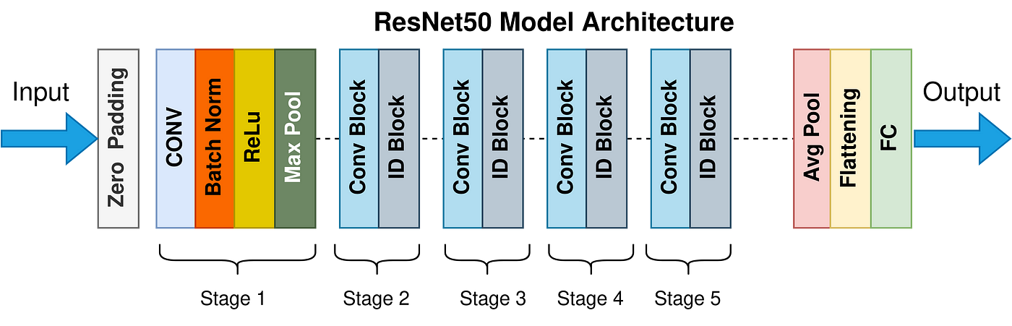
Common Feed-Forward Architectures
ResNet – multipurpose, relatively lightweight, adaptable and powerful
y = F(x) + x, a residual (Res) block
MobileNet – optimized for edge devices, efficient
VGG – common, heavy, fully connected, though outdated
VisionTransformers – uses self-attention (transformers) on patches
Image: https://miro.medium.com/v2/resize:fit:1400/0*tH9evuOFqk8F41FG.png

Slide 34
Exercise 1: Dataset Exercise 2: Model
t.ly/VRj8T | t.ly/C1Nxe GitHub | Google Colab
Est: 10+10 min

Slide 35
Model Hubs
Pytorch/Torchvision Hubs:
https://pytorch.org/docs/stable/hub.html
https://pytorch.org/vision/stable/models.html
HuggingFace
https://huggingface.co/models
And more...

Slide 36
Contents
Introduction
Thinking About Data
Good data, bad data, what is our goal?
Choosing a Model
What to be aware of, where to look, thinking architecture
Exercises
The Training Loop
Loss, optimizers, validation techniques, detecting flaws in our regime
Is My Model Doing What it is Supposed To?
Breaking down the problem, debugging, and generalization
Exercises
Final Thoughts

Slide 37
Loss
Error function: How wrong was our guess?
How do we quantify this for regression problems?
L2: (1/N) * sum(F(x) - t)², Mean Square Error – penalizes outliers significantly
This does not work well for classification
Category 2 and 3 are no more similar than category 2 and 17
Here, we normally use Log Loss (Binary/Categorical Cross Entropy)
Our labels are always binary
BCE = L(F(x), t) = -(t * log(F(x)) + (1 – t) * log(1 – F(x)))

Slide 38

Optimizers
Methods for optimizing the network for our loss function
Gradient descent operates on each layer's gradients during backpropagation
Updates the weights of our network based on learning rate and loss
Many implementations optimize differently, using e.g. momentum
Adam is our go-to
Uses decaying average of past gradients
If Adam does not work, chances are something else is wrong
https://miro.medium.com/v2/resize:fit:640/format:webp/1*XVFmo9NxLnwDr3SxzKy-rA.gif

Slide 39
Neural Network Training: Step by Step
An epoch begins
Set model to training, start collecting batch losses
Run training loop:
Fetch data and targets from our dataloader, giving us x and t
Reset (zero) our gradients
Run the model using our data, giving us F(x)
Compute loss using F(x) and t
Do backpropagation, computing the gradients
"Step" with the optimizer, calculating our parameters anew using the gradients
Calculate the average loss, set model to evaluation mode
Run evaluation loop

Slide 40
Contents
Introduction
Thinking About Data
Good data, bad data, what is our goal?
Choosing a Model
What to be aware of, where to look, thinking architecture
Exercises
The Training Loop
Loss, optimizers, validation techniques, detecting flaws in our regime
Is My Model Doing What it is Supposed To?
Breaking down the problem, debugging, and generalization
Exercises
Final Thoughts

Slide 41
Debugging
Export model
Isolate the core problem
Minimize external factors
Build up step by step
Training Loop:
Push to device,
Calc loss0...lossN
Backprop & optimize
Evaluate
Dataset
Load,
Augment,
Batch

Slide 42
Dataset
Dataset
Visualization
Regardless of format, humans are good at spotting anomalies when presented with visual information
Show N samples of data along with their annotations (label, bounding boxes, etc)
Correlation
Statistics, graphs for subsets of data (categories, data sources)
Never assume data is good
100 raw photos taken with a Nikon ZF != compressed video feed from fisheye
Sometimes, your data is not enough

Slide 43
Dataloader
Load,
Augment,
Batch
Visualization (again)
Visualize a batch
Try to backtrack, "unnormalize"
Visualize targets
Keep statistics if necessary

Slide 44
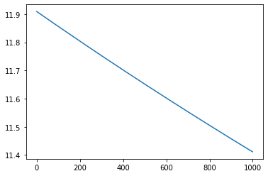
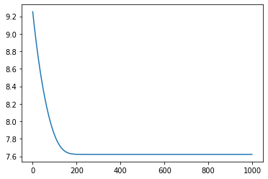
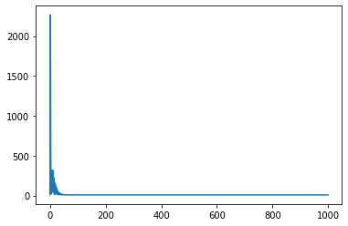
Training
Training Loop:
Push to device,
Calc loss0...lossN
Backprop & optimize
Evaluate
Before you begin, overfit!
Fetch one batch of data, visualize it
Run training only on this batch
Visualize the loss(es) and results as you go

Slide 45
Training
Training Loop:
Push to device,
Calc loss0...lossN
Backprop & optimize
Evaluate
If all else fails,
Run training on CPU
with torch.autograd.detect_anomaly():
Discover failure modes:
NaN calculations (near-0 gradients, division by 0, etc)
Out of Bounds Errors

Slide 46
Exercise 3: Training Loop Exercise 4: Debugging
t.ly/VRj8T | t.ly/C1Nxe GitHub | Google Colab
Est: 10+10 min

Slide 47
Contents
Introduction
Thinking About Data
Good data, bad data, what is our goal?
Choosing a Model
What to be aware of, where to look, thinking architecture
The Training Loop
Loss, optimizers, validation techniques, detecting flaws in our regime
Is My Model Doing What it is Supposed To?
Breaking down the problem, debugging, and generalization
Final Thoughts

Slide 48
Data Quality
Deep Learning is data-driven
Data is critical
Amount
Quality
Distribution (and target distribution)
If you have less data, finetuning a pretrained model may work
We have been finetuning pretrained models today!

Slide 49
MLOps
Like DevOps, but for data Machine Learning development
How do we iterate the development process?
How do we train and test our models effectively?
How do we deploy, maintain, and evaluate our models?
Common: https://mlflow.org/ + https://dvc.org/
Alexandra's: https://alexandrainst.github.io/factory-ml/
Learn more here: https://alexandra.dk/tdu-factory-ml-nem-implementering-af-maskinlaering-i-produktionen/

Slide 50
What now?
Try using GradCam on our newly trained model
It shows us which areas our model "activates" on to provide our result
https://github.com/jacobgil/pytorch-grad-cam
Torchvision tutorials are very good
Learn more about neural network architecture, data, and objectives
https://pytorch.org/tutorials/intermediate/torchvision_tutorial.html
Try saving and loading a model to understand their format
https://pytorch.org/tutorials/beginner/saving_loading_models.html
Use a visualizer to see what they look like: https://netron.app/

Slide 51
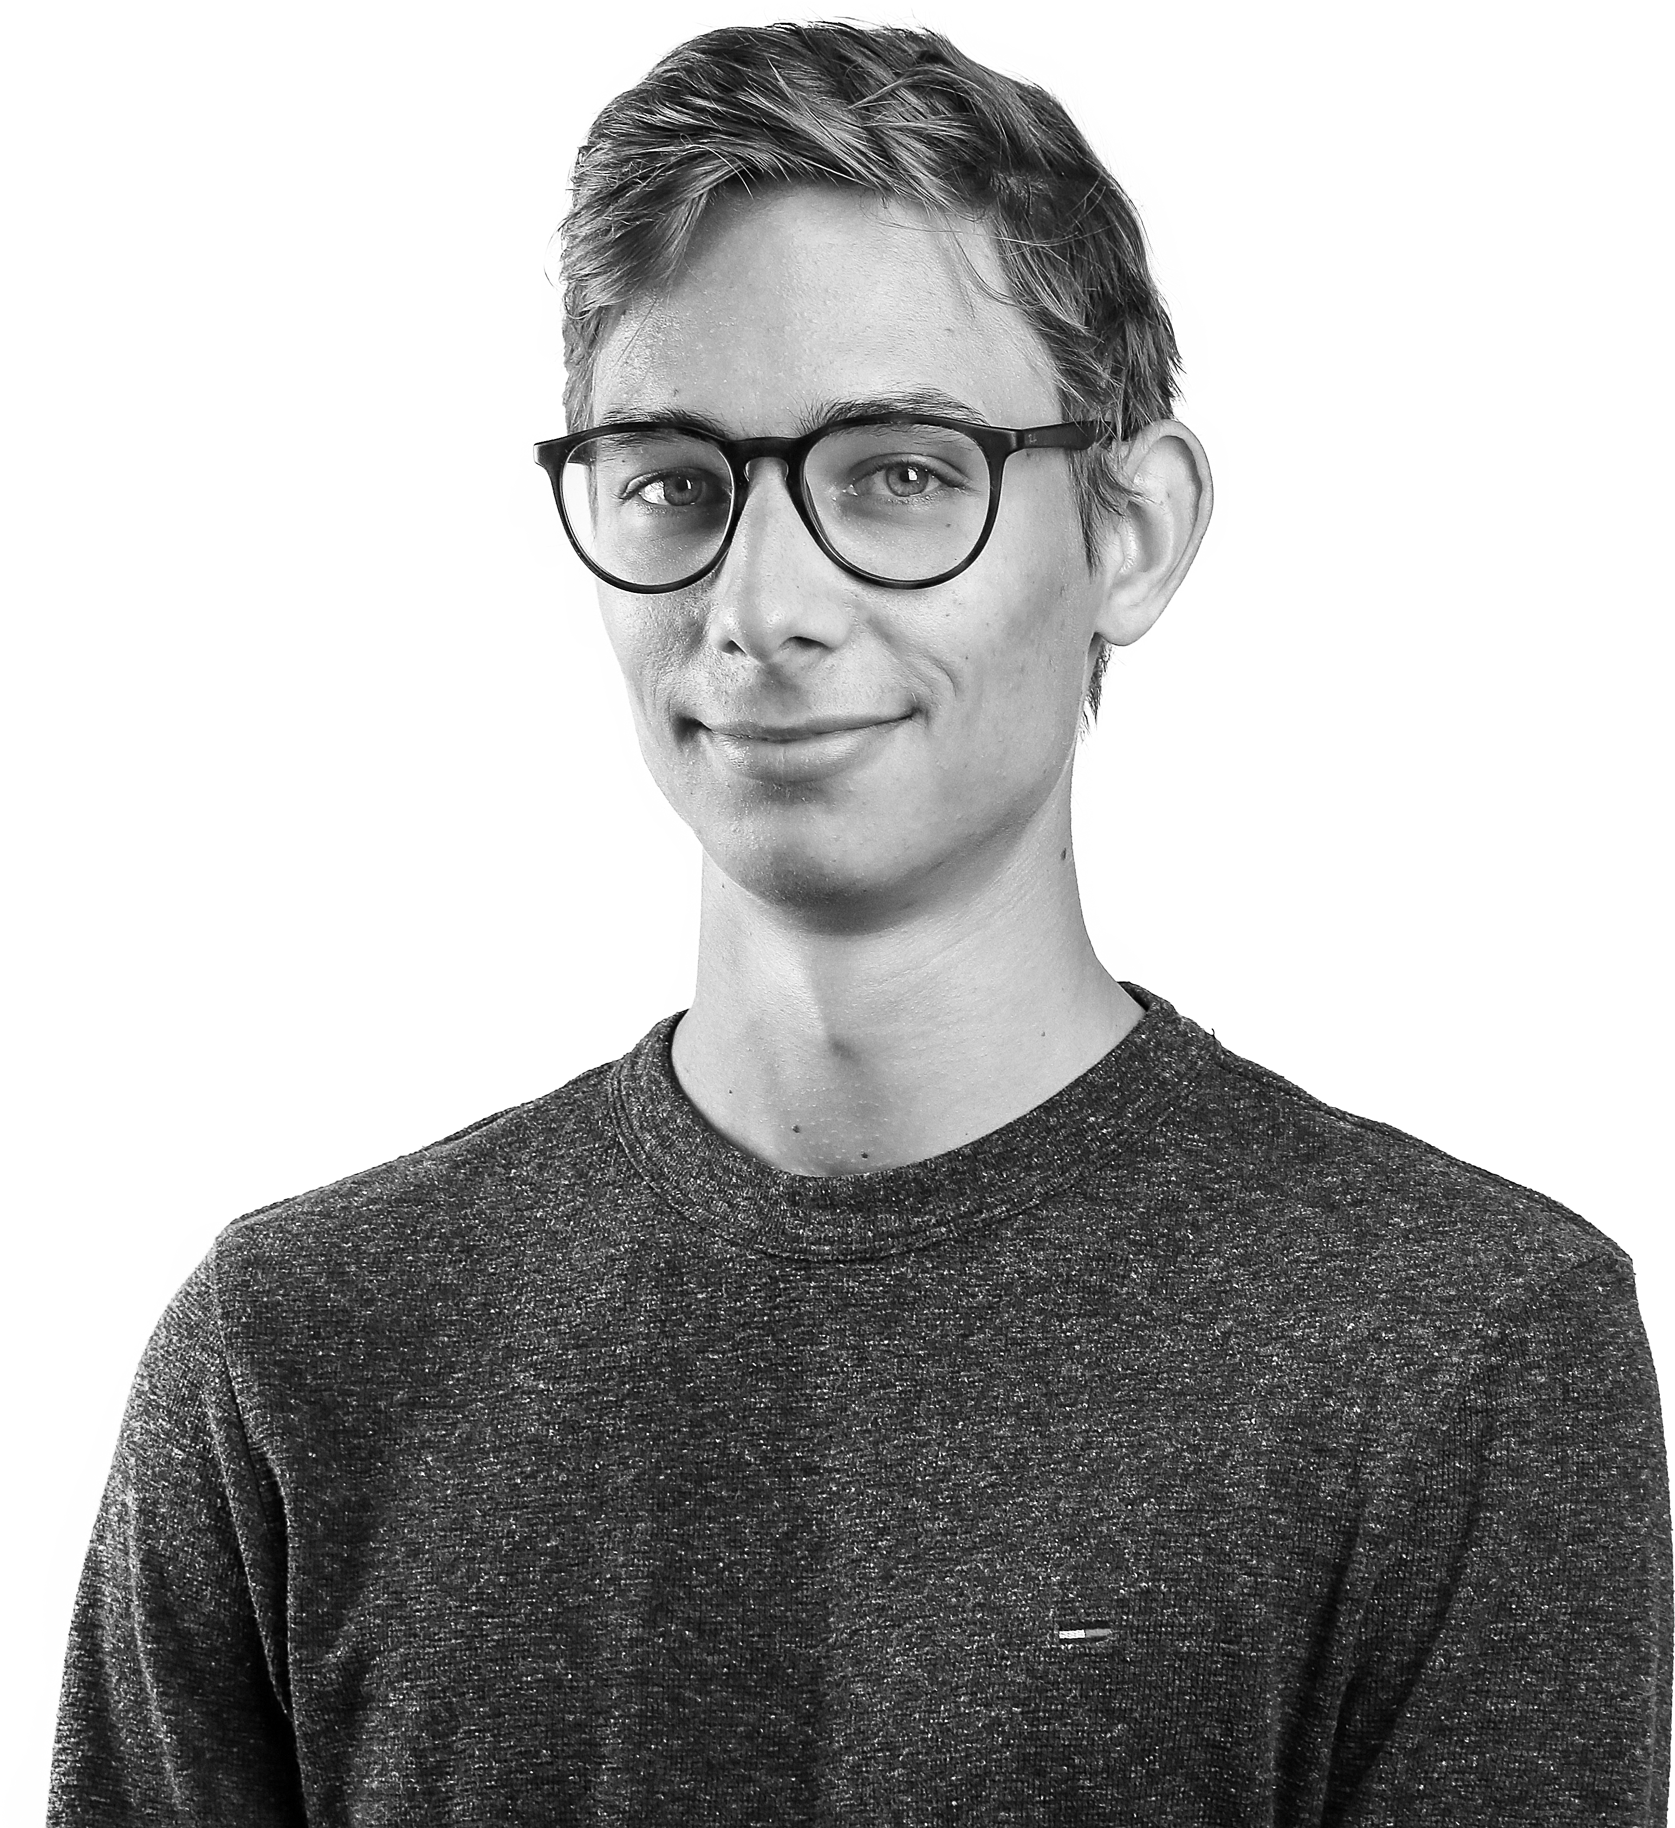
Klar til dialog
Oliver Gyldenberg Hjermitslev
Senior Visual Computing Specialist
oliver.gyldenberg@alexandra.dk
linkedin.com/in/oliver-g-hjermitslev

